Slide 1
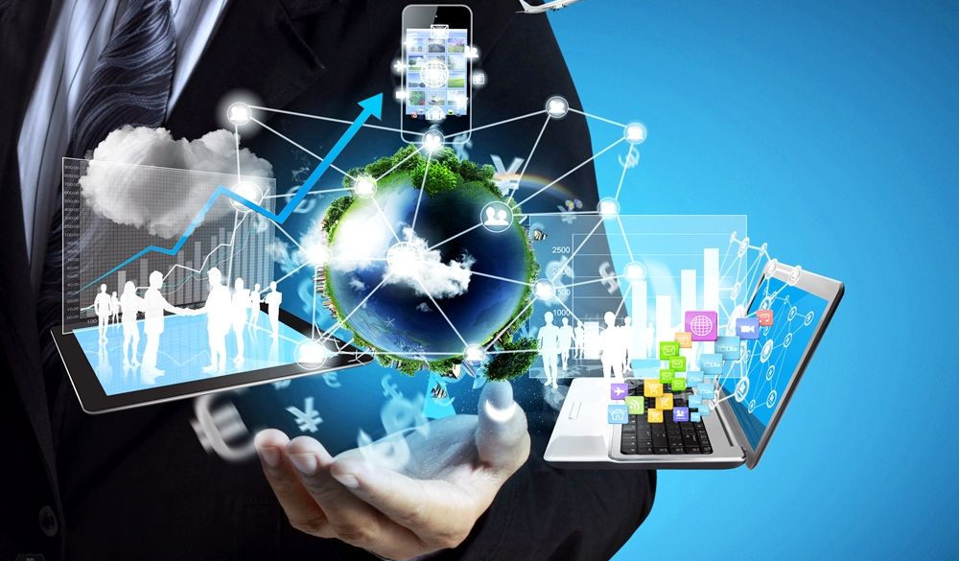
Introduction to Information and Communication Technologies

Slide 2

ICT
Information
Any entity or form that provides the answer to a Question
Communication
Act of transferring information from one place to another
Technology
Collection of techniques, methods and processes used to produce goods or services or accomplish objectives.

Slide 3

Do you use ICT

Slide 4
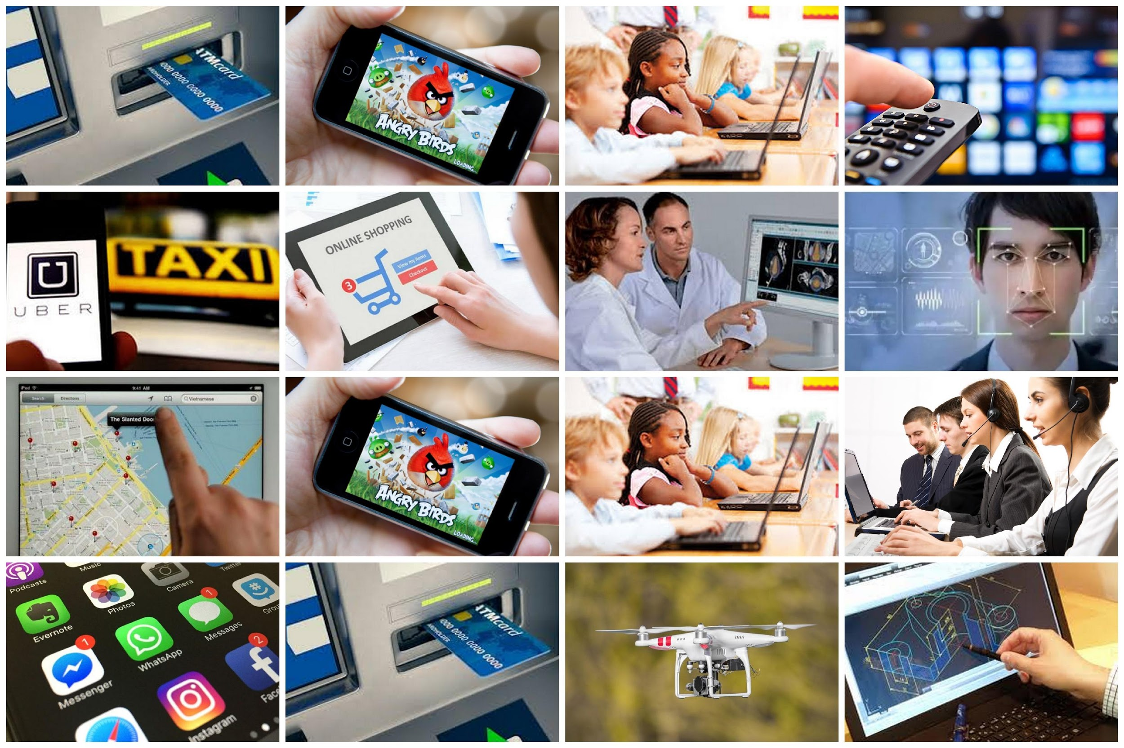

Slide 5
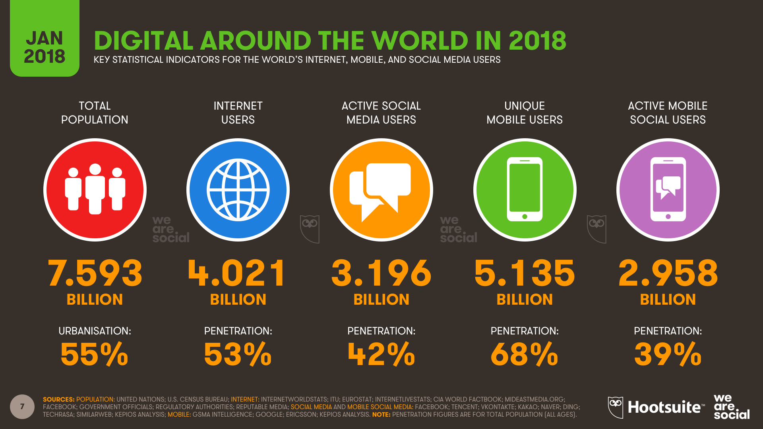
Amazing Facts and Statistics

Slide 6
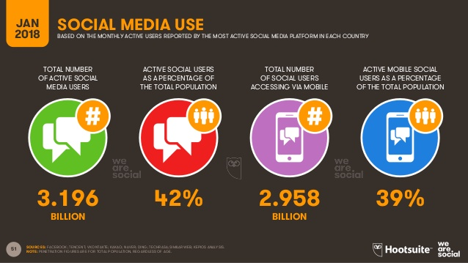
Amazing Facts and Statistics

Slide 7
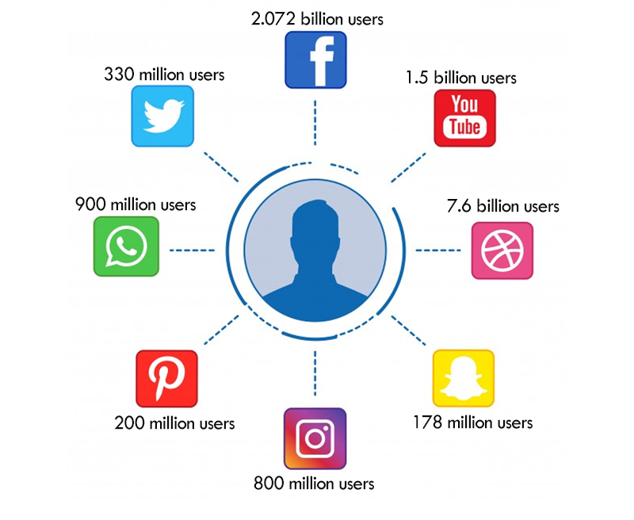
Amazing Facts and Statistics

Slide 8
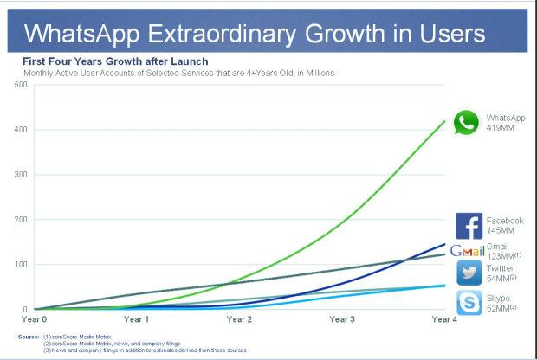
Amazing Facts and Statistics

Slide 9
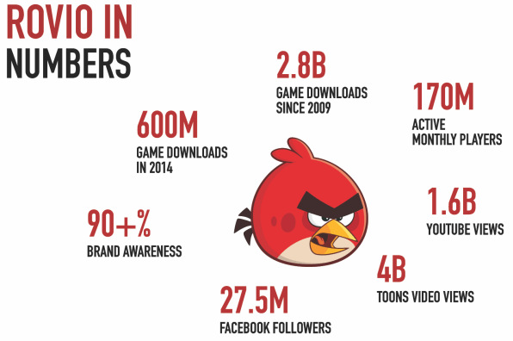
Amazing Facts and Statistics

Slide 10
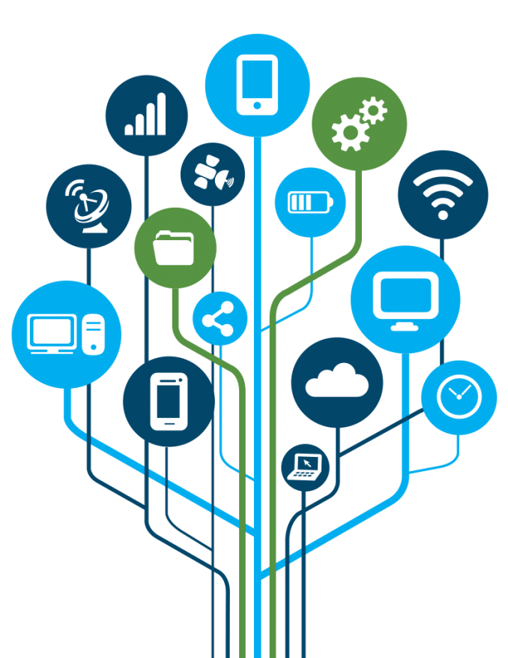
What is ICT
ICT can be defined as the set of technological tools and resources used to communicate and create, disseminate, store and manage information.
These technologies include computers, internet, broadcasting technologies and telephony.

Slide 11
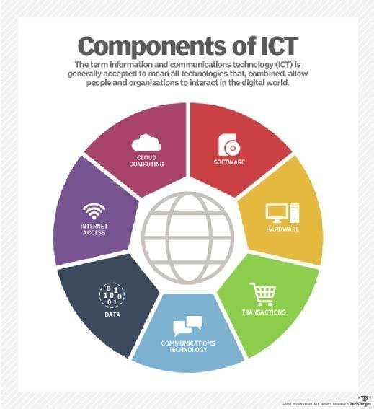
Components of ICT

Slide 12
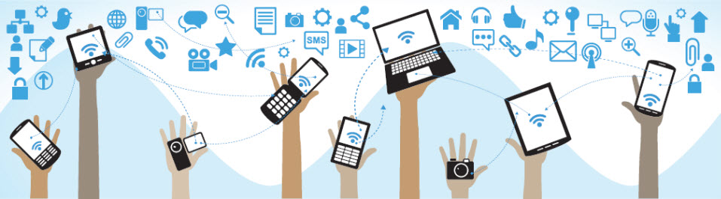
Communication Devices
Computers
Mobile phones
Cameras
Gaming consoles
Home entertainment Systems
Media Players and so on…

Slide 13
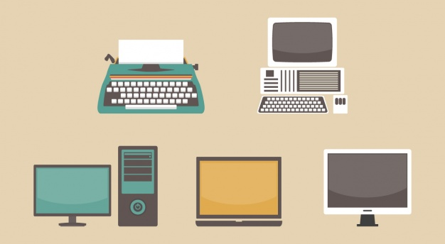
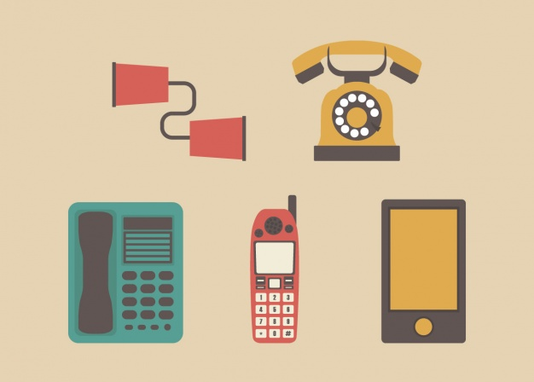
Device Evolution

Slide 14
Impact of ICT on society
Developments in ICT have brought about the merger of
the computing,
information,
communications,
entertainment,
mass media industries
thereby providing a means of exchanging information in the digital format used by computers.

Slide 15
Transition
Shift from Print to Digital
Internet
ICT has made the transfer of digital information from remote sites possible

Slide 16
What is a Computer
Advanced electronic device
Takes raw data as input
Process it under control of set of instructions
Produces results
Saves it for future

Slide 17
Few Basics
Computers
A computer is an electronic machine that has the capability to perform certain types of processing/computation on the supplied data. It can also store the data as well as generated results.
Processing/
Computation
Data & Instructions
Information/Results
Storage

Slide 18
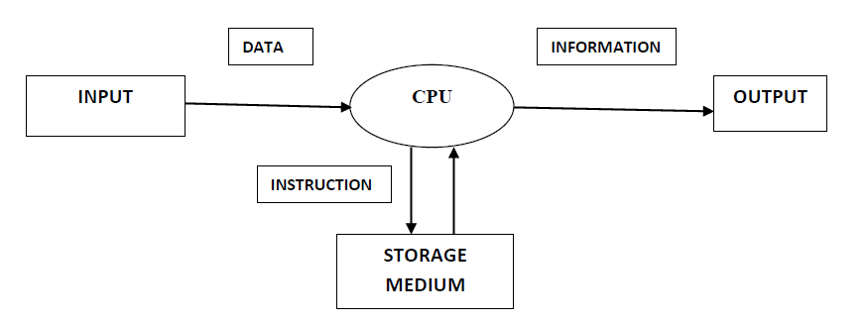
Functions of Computers
1. Takes data as input
2. Stores data/instructions in its memory and uses them as required
3. Process data and converts it into information
4. Generates the output
5. Controls all of the above steps

Slide 19
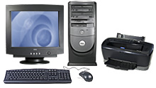
Few Basics
Computers
Device that accepts input, process and stores data, and gives output
Device that can execute specific set of instructions in a well-defined manner

Slide 20
Few Basics….
Computer
Hardware
Software
CPU
Memory
I/O
Etc.
Application
Software
System
Software

Slide 21
Few Basics
Computer Hardware
Electric, electronic, and mechanical devices
Computer Software
Programs and data in electronic form on a storage medium
Program- Sequence of Instructions

Slide 22
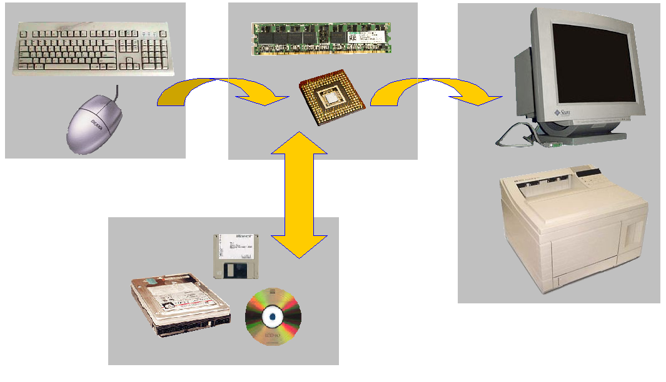
Few Basics: Hardware

Slide 23
Few Basics
Input devices
Processor & Memory
Storage devices
Output devices

Slide 24
Few Basics: Input Devices
Mouse
Keyboard
Joystick
Camera
Microphone

Slide 25

Computer Applications
Business
Payroll calculations
Budgeting
Sales analysis
Financial forecasting
Managing employees
Stock maintenance

Slide 26
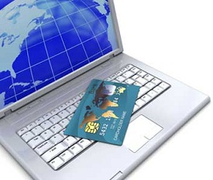
Computer Applications
Banking
Online banking (checking balance, funds transfer etc.)
ATM (automated teller machine)
Insurance
Procedure to continue with policies
Starting date of the policies
Next due installment of a policy

Slide 27

Computer Applications
Education
The computer provides a tool in the education system known as CBE (Computer Based Education).
CBE involves control, delivery, and evaluation of learning.
Computer education is rapidly increasing the graph of number of computer students.
There are a number of methods in which educational institutions can use a computer to educate the students.
It is used to prepare a database about performance of a student and analysis is carried out on this basis.

Slide 28
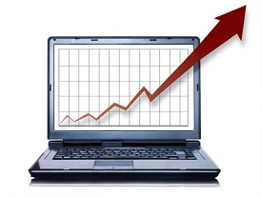
Computer Applications
Marketing
Advertising − With computers, advertising professionals create art and graphics, write and revise copy, and print and disseminate ads with the goal of selling more products.
Home Shopping − Home shopping has been made possible through the use of computerized catalogues that provide access to product
information and permit direct entry
of orders to be filled by the customers.

Slide 29

Computer Applications
Healthcare
Diagnostic System − Computers are used to collect data and identify the cause of illness.
Lab-diagnostic System − All tests can be done and the reports are prepared by computer.
Patient Monitoring System − These are used to check the patient's signs for abnormality such as in Cardiac Arrest, ECG, etc.
Pharma-Information System − Computer is used to check drug labels, expiry dates, harmful side effects, etc.
Surgery − Nowadays, computers are also used in performing surgery.

Slide 30
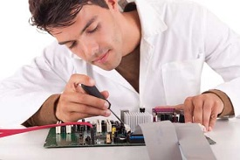
Computer Applications
Engineering Design
Structural Engineering − Requires stress and strain analysis for design of ships, buildings, budgets, airplanes, etc.
Industrial Engineering − Computers deal with design, implementation, and improvement of integrated systems of people, materials, and equipment.
Architectural Engineering − Computers help in planning towns, designing
buildings, determining a range of
buildings on a site using both 2D
and 3D drawings.

Slide 31
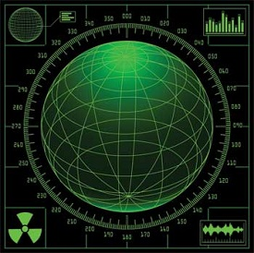
Computer Applications
Military
Missile Control
Military Communication
Military Operation and Planning
Smart Weapons

Slide 32

Computer Applications
Communication
E-mail
Chatting
FTP
Video-conferencing

Slide 33
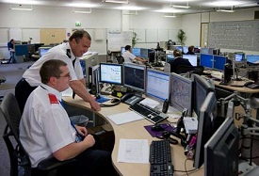
Computer Applications
Government
Budgets
Sales tax department
Income tax department
Computation of male/female ratio
Computerization of voters lists
Computerization of CNIC card
Weather forecasting

Slide 34
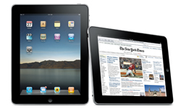
Types of Computer
PC (Personal Computer )
Small
Inexpensive
Business Use
Word processing, running spreadsheets etc.
Personal Use
Playing games, surfing the internet, movies, games etc.
Single user system

Slide 35
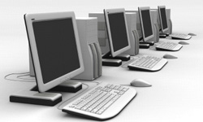
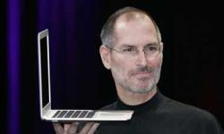
Types of Computer
Desktop
PC not designed for portability
More storage and computation with less cost
Laptop (notebook)
Portable with integrated display
Battery operated

Slide 36
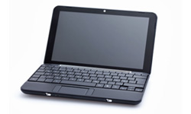
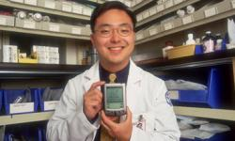
Types of Computer
Netbook
Smaller and cheaper than laptops
Less powerful than laptop
PDA (personal digital assistant)
Tightly integrated computer
Flash memory instead of hard disk
Touch screen instead of keyboard
Lightweight and reasonable battery life

Slide 37
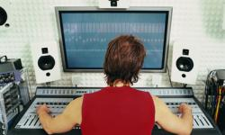
Types of Computer
Workstation
Desktop computer with more processing power
More memory
More capabilities in performing specialized tasks

Slide 38
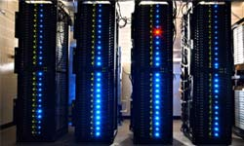
Types of Computer
Server
Computer that serves other computers over network
More processing power, memory and storage
Large in size

Slide 39
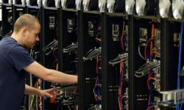
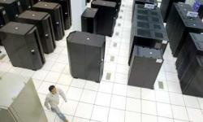
Types of Computer
Mainframe
Very large size
Now known as enterprise server
More processing power
Supercomputer
Very expensive
Fastest computers
Employed for specific applications which require immense amount of calculations
weather forecasting
scientific simulations
(animated) graphics
nuclear energy research
electronic design

Slide 40
Advantages of Computer
High Speed
Units of speed in microsecond and nanosecond
It can perform millions of calculations in few seconds where it will take months for a human to perform same calculations
Accuracy
100 % error free
Storage
More storage capacity than humans
All types of images can be stored

Slide 41
Advantages of Computer
Diligence
Free from tiredness and lack of concentration
Can work continuously without error and boredom
Repeated task with same time and accuracy
Versatility
solves different problems
Solving complex problems
Games
Reliability
Machines with long lives
Easy maintenance

Slide 42
Advantages of Computer
Automation
Computer is automatic machine
After taking input and program, then it can process without human interaction
Reduction in manual work and paper cost
Data stored inside computers electronically reduces paper cost
Increases speed
Data retrieved easily and speedily when required

Slide 43
Disadvantages of Computer
No I.Q.
No intelligence
Instructions given to computer
Cannot take decisions
Dependency
Depends on instructions given by humans
No Feeling
Cannot make judgment on feelings, taste, experience, knowledge

Slide 44
Course Details
Week | Topic
1 | Introduction
2 | Number System
3 | Computer Organization
4 | Math in Computer Science
5 | Operating Systems
6 | Data Management
7 | Big data
8 | Communication
9 | Web development
10 | Artificial Intelligence
11 | Computer Graphics
12 | Exam
13-14 | Student Presentations
Weekly Activities + Attendance 25%
Final Presentation 25%
Exam 50%

Slide 45
Activity
Share with us every type of digital device that you own and then figure out the percentage of those devices that are used for data processing.
Share with us the types of activities that you conduct on your digital devices and then figure out the percentage of activity that does not require internet access.

Slide 46
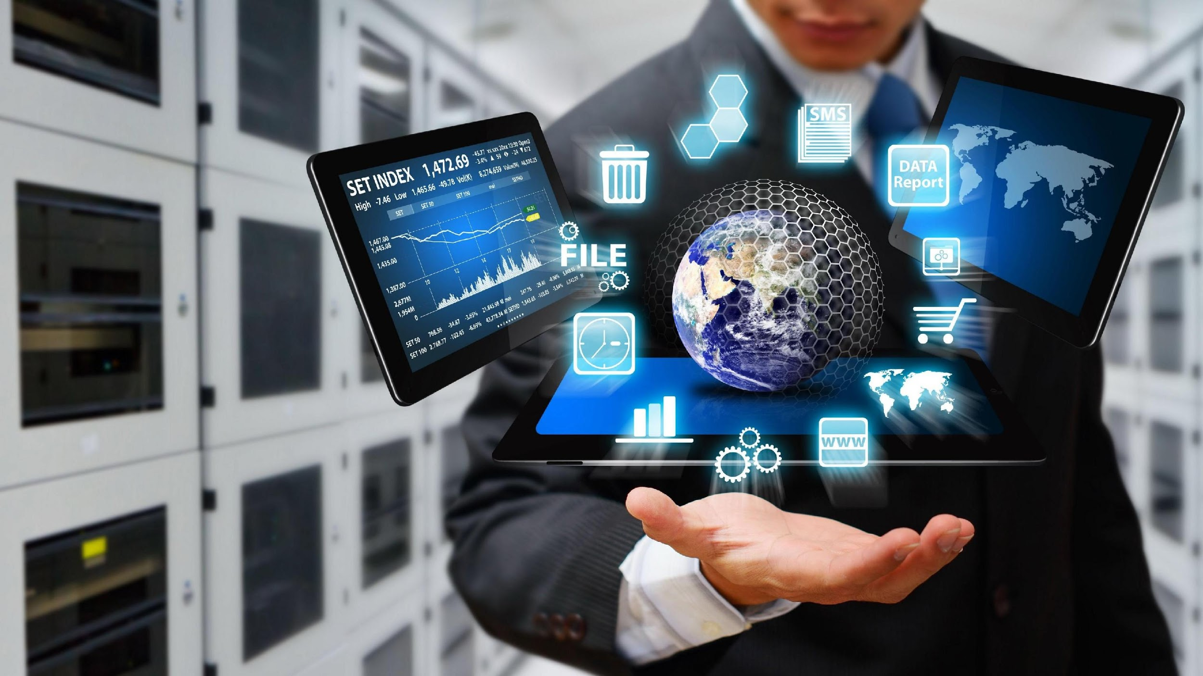
Thank You

